Slide 1
Next time
Add slide about nicely laying out schematic
Talk about layers
Remember to talk about decoupling
And GND, BAT_GND, and the bridge

Slide 2
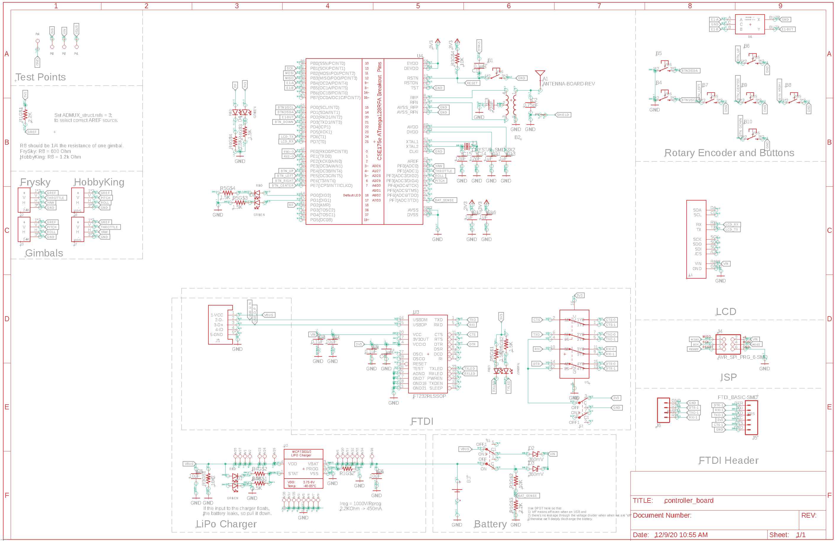
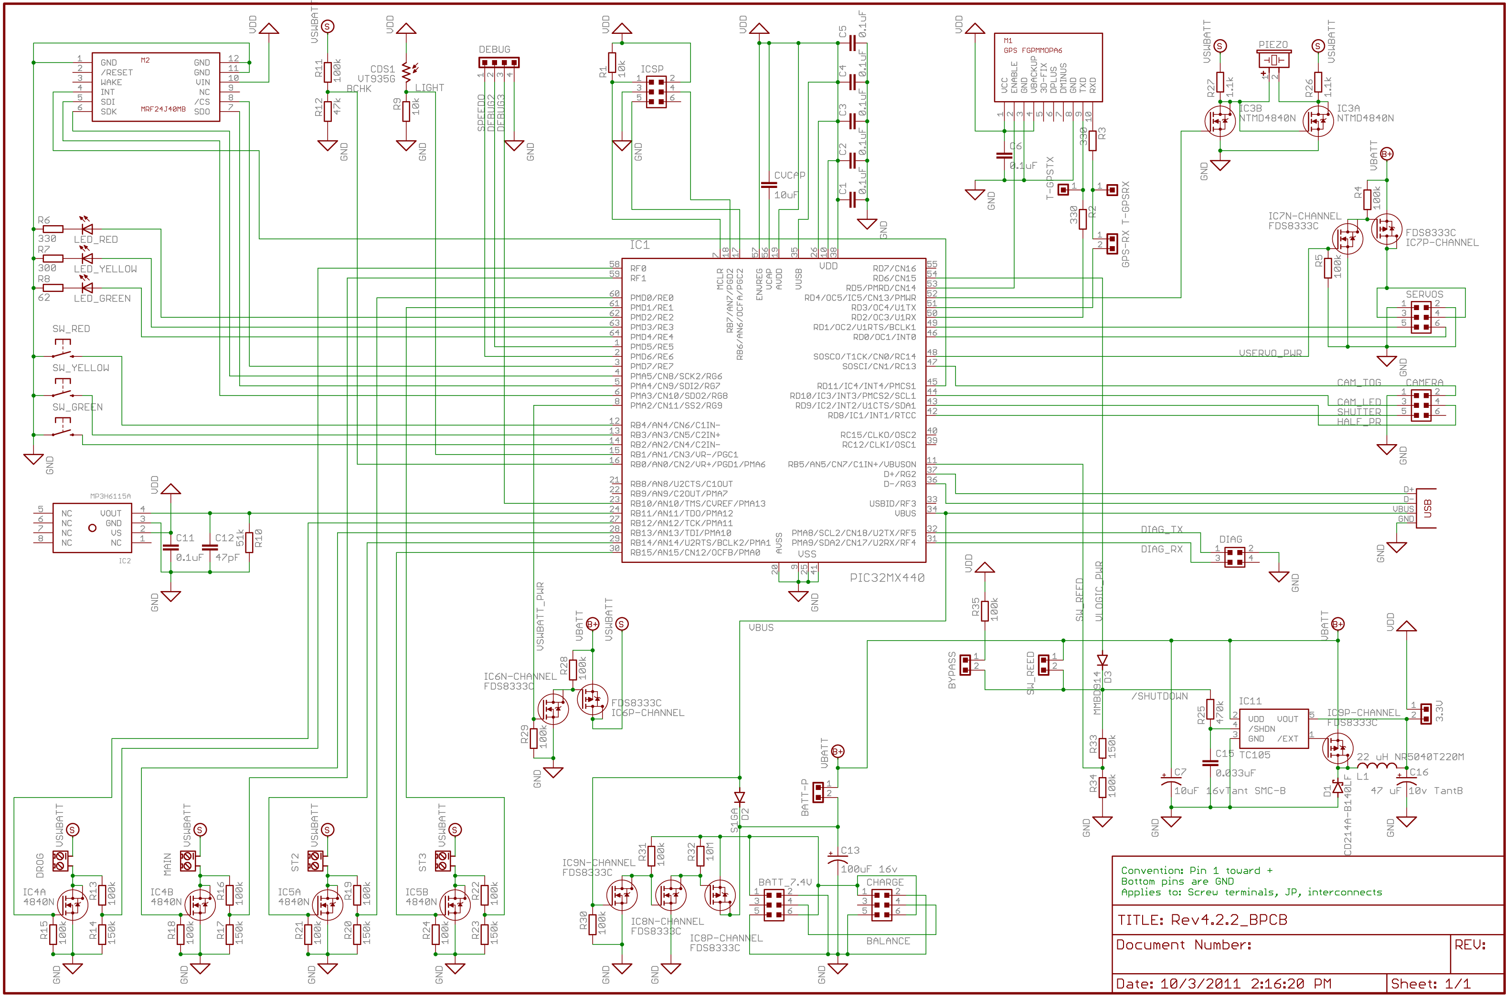

Slide 3
Designing Nice Schematics
Dr. Steven Swanson
CSE176e/276e
swanson@cs.ucsd.edu

Slide 4
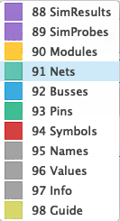
Schematic Layers in Eagle
Eagle (and other tools) use layers to for different schematic information.
Nets – wires (electrical connections)
Pins – Connection points on symbols
Symbols – symbols
Names – symbol and pin names
Values – symbol values (e.g., resistance for resistors)
Info – Documentation
We won’t use the others

Slide 5
Demo
Show what’s in each of the layer
Good Schematic style
Bad Schematic Style
Eagle Pitfalls

Slide 6
Building The Quadcopter Schematic

Slide 7
Schematics Goals
Determine what components your PCB will hold
Define the electrical connectivity between those components
Specify some metadata about the parts

Slide 8
Eagle Pitfalls
Always edit schematics with your grid set to 0.1” or 0.05” – ALWAYS!!!
Wires/pins can look connected but not be.
‘Wiggle’ parts to make sure wires move with them.
Check for the green dot.

Slide 9
Electrical Rules Check
This checks for common problems in schematics.
Make sure you understand the reason for the errors.
Fix them if you can.
Run it!

Slide 10

The Hardware You will Build

Slide 11
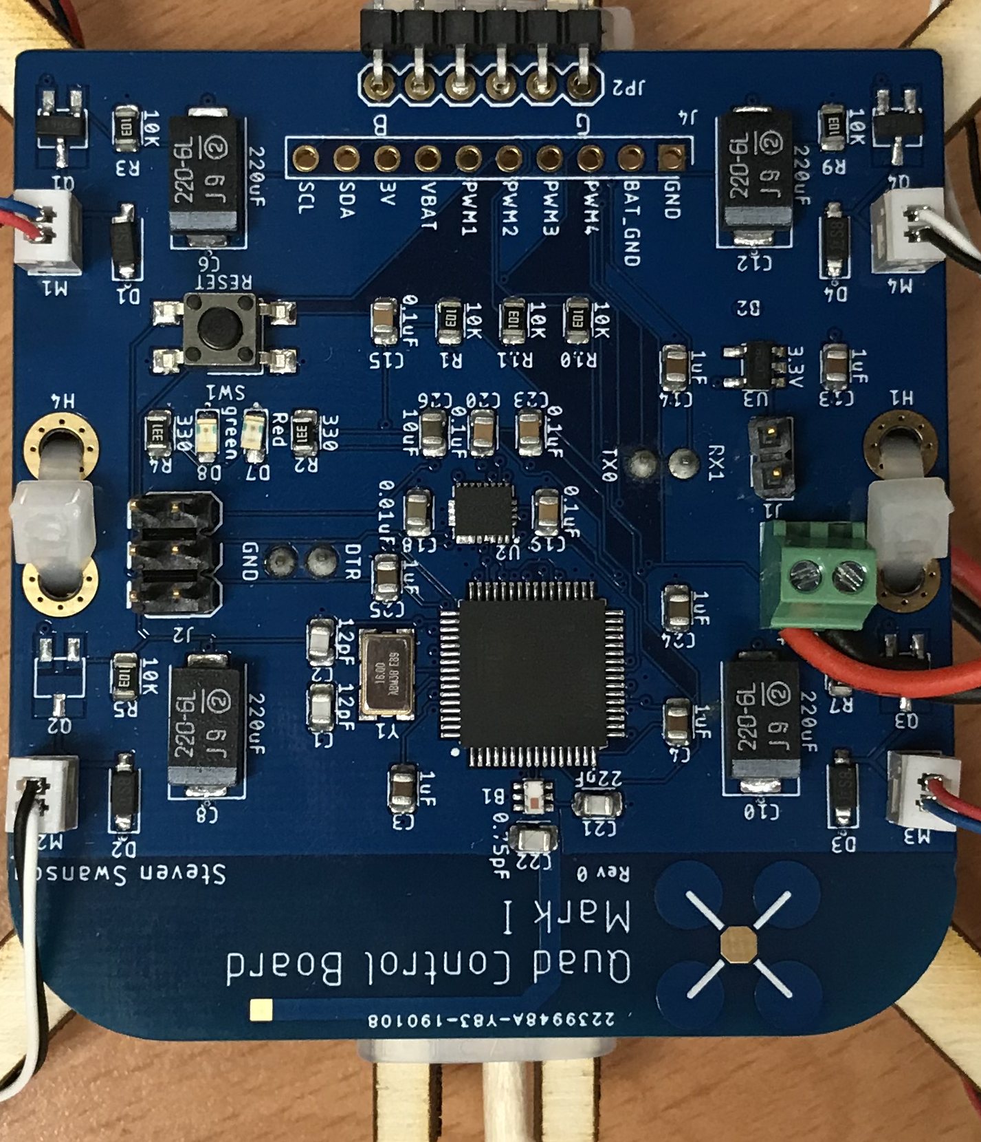
The Hardware You Will Build

Slide 12
Three Schematic Design Skills
Copy – You will manually copy the microcontroller circuit from a small breakout board that uses the same MCU.
Copy – you’ll copy the motor controller based on a schematic I provide.
Implement – You will look at the data sheet for the IMU and voltage regulator and implement the design it provides.
Design – you will add some LEDs to your design on your own.

Slide 13
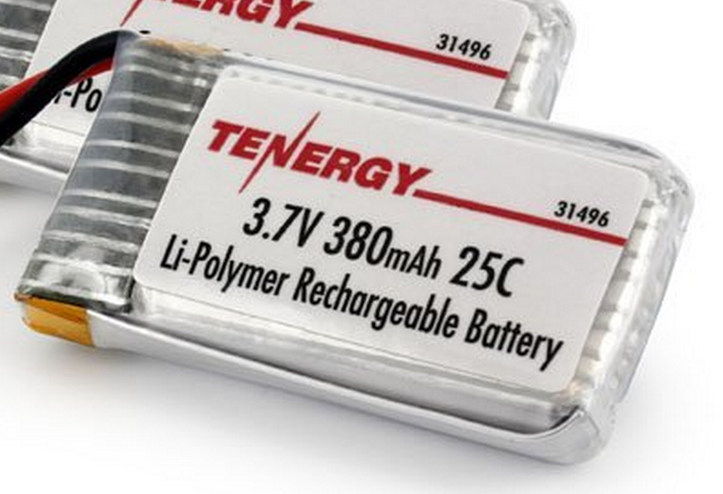
Power Supply
Lithium Polymer Battery
370 Mah
Max 9.25 Amps
Nominal voltage = 3.7-4.2V
Powers the motors directly
3.3V low dropout (LDO) voltage regulator
Powers the microcontroller and the IMU

Slide 14
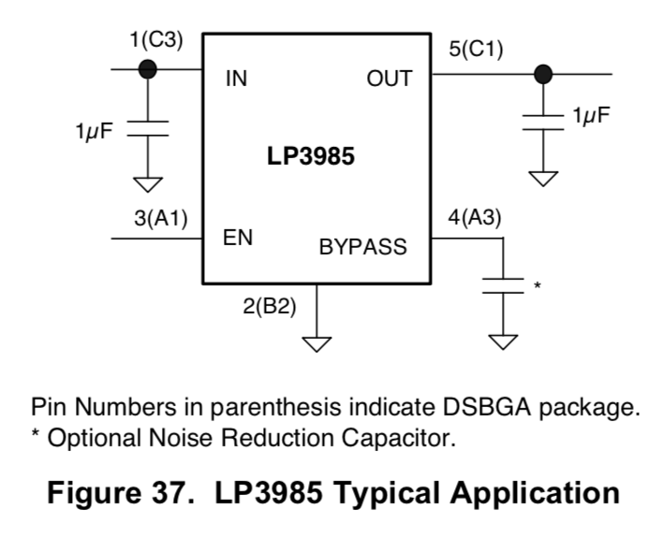
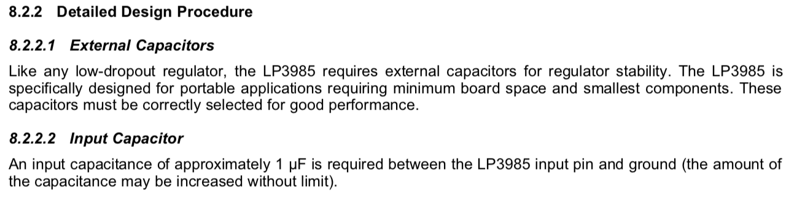
Voltage Regulator Datasheet

Slide 15
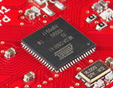
Flight Computer
ATmega128RFA1 microcontroller
Arduino compatible
16Mhz clock
128KB Flash
16KB SRAM
4096B EEPROM
2.4GHz radio (Compatible with Zigbee)

Slide 16
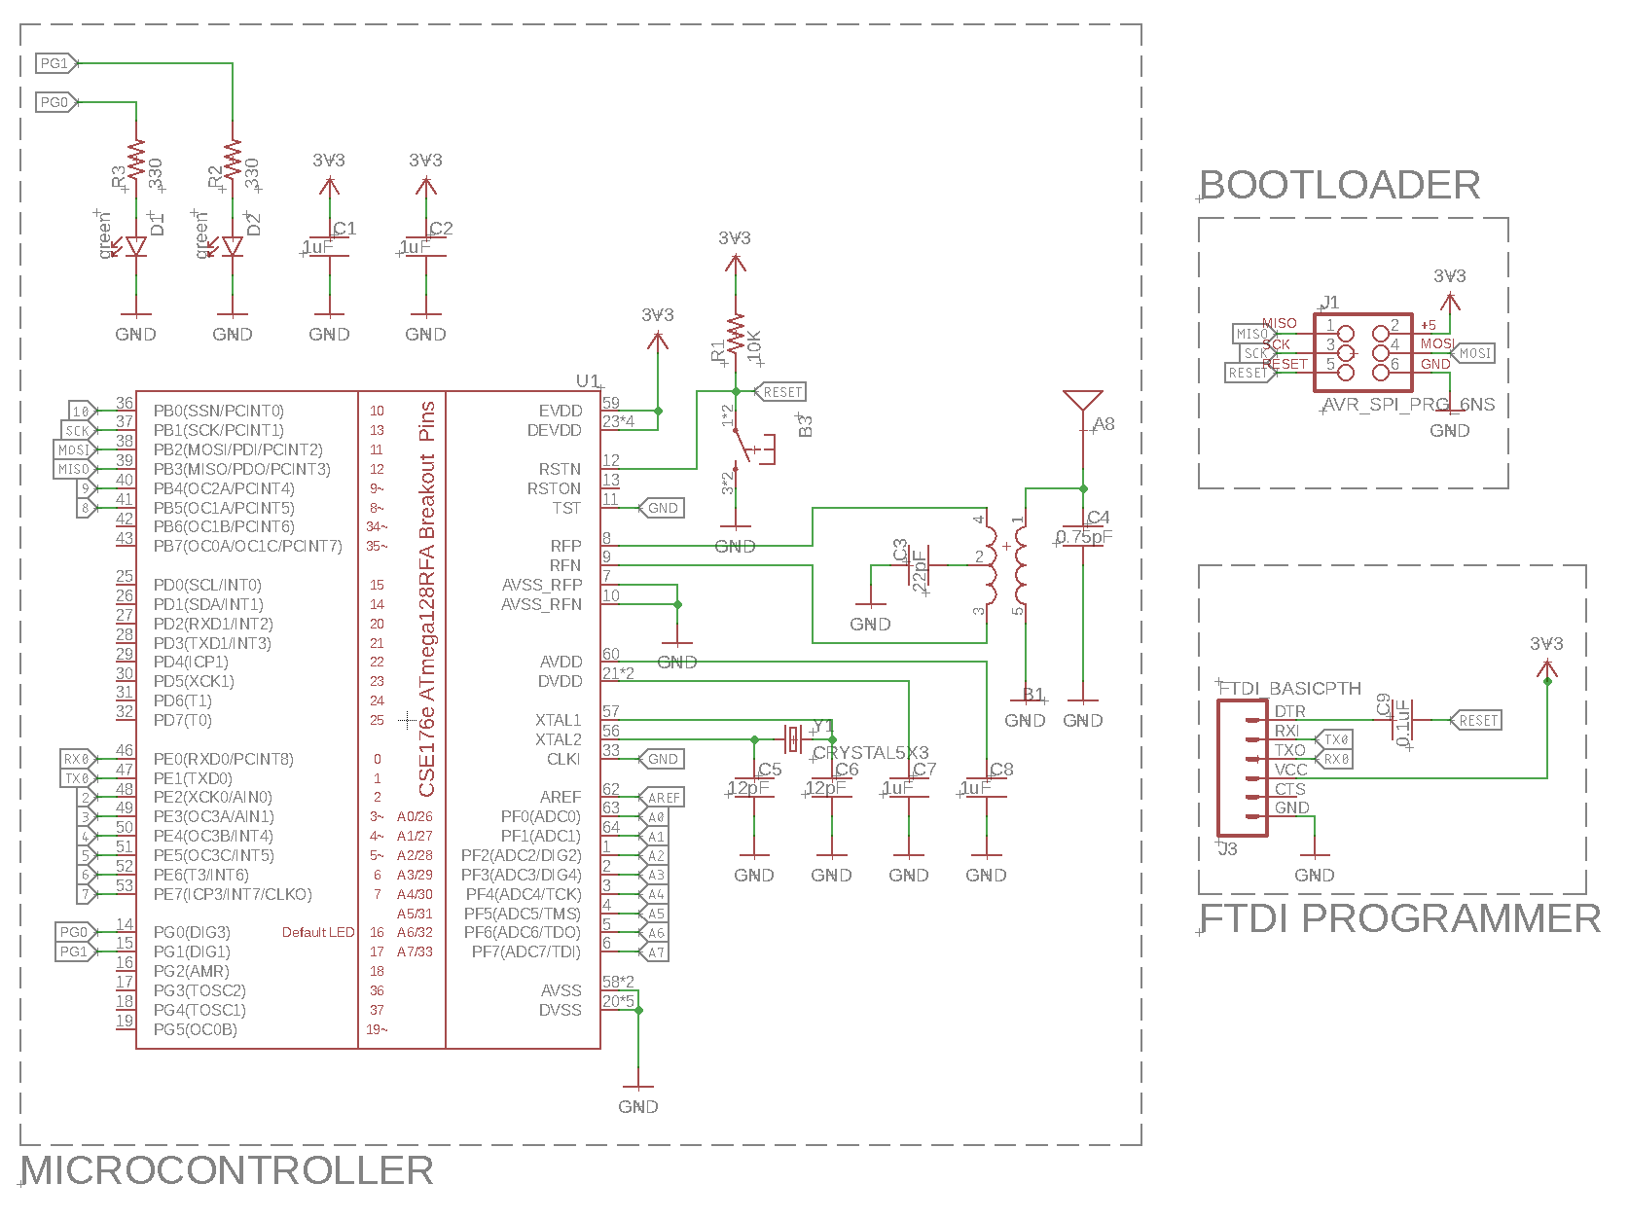
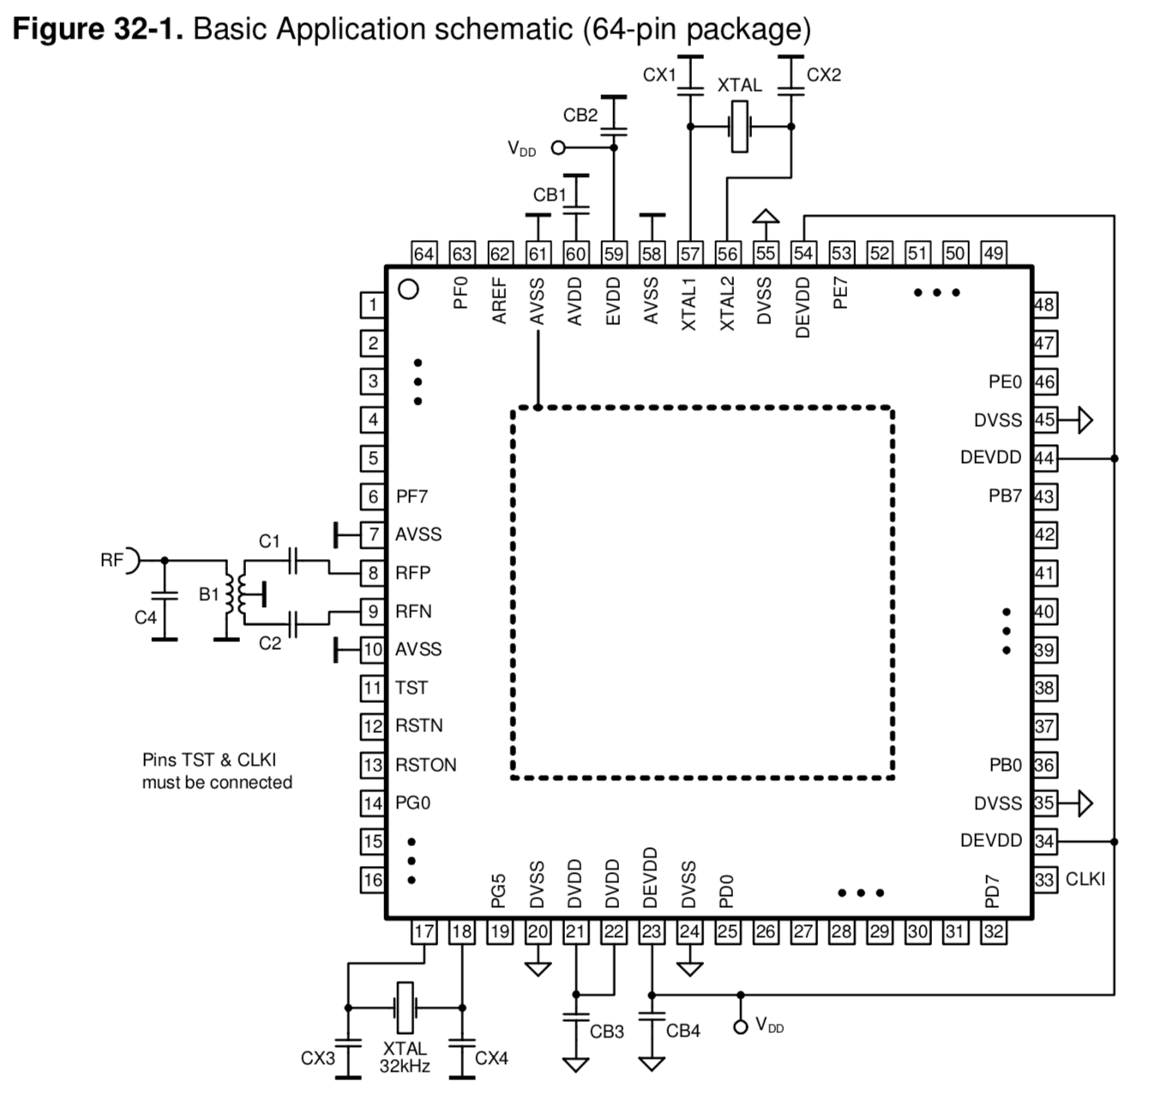
uController Datasheet and Reference Design

Slide 17
Decoupling Capacitors

Slide 18
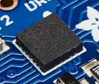
Inertial Measurement Unit
STMicro LSM9DS1
9-axis sensor
3-axis accelerometer
3-axis magnetometer
3-axis gyroscope
We will use the I2C interface

Slide 19
Why I²C?
Pins are precious!
They take up space
More pins → More expensive microcontrollers
Adding pins is hard
Might need a new microcontroller (if a larger, compatible one is available)
Significant board changes
Performance is often not that important
So
Use the minimum number of pins
Run them at relatively low bit rates.

Slide 20
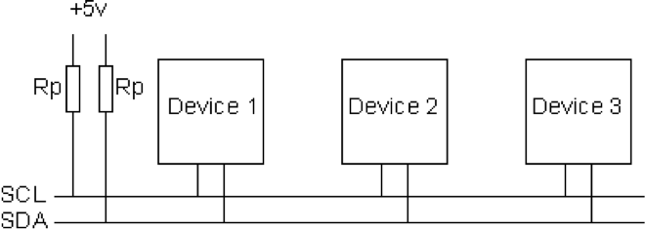
I2C Bus Architecture
Two signals
SCL – Serial Clock (used for coordination and timing)
SDA – Serial Data (used for data and control signaling)
Both pulled up to VCC via a large resistor (e.g. 10 kΩ)
Two I2C roles
A master that initiate communication (The MCU)
Up to 127 slaves that can respond (The IMU)
Two operations: Read and write
The master can read and write registers specified by an address.

Slide 21
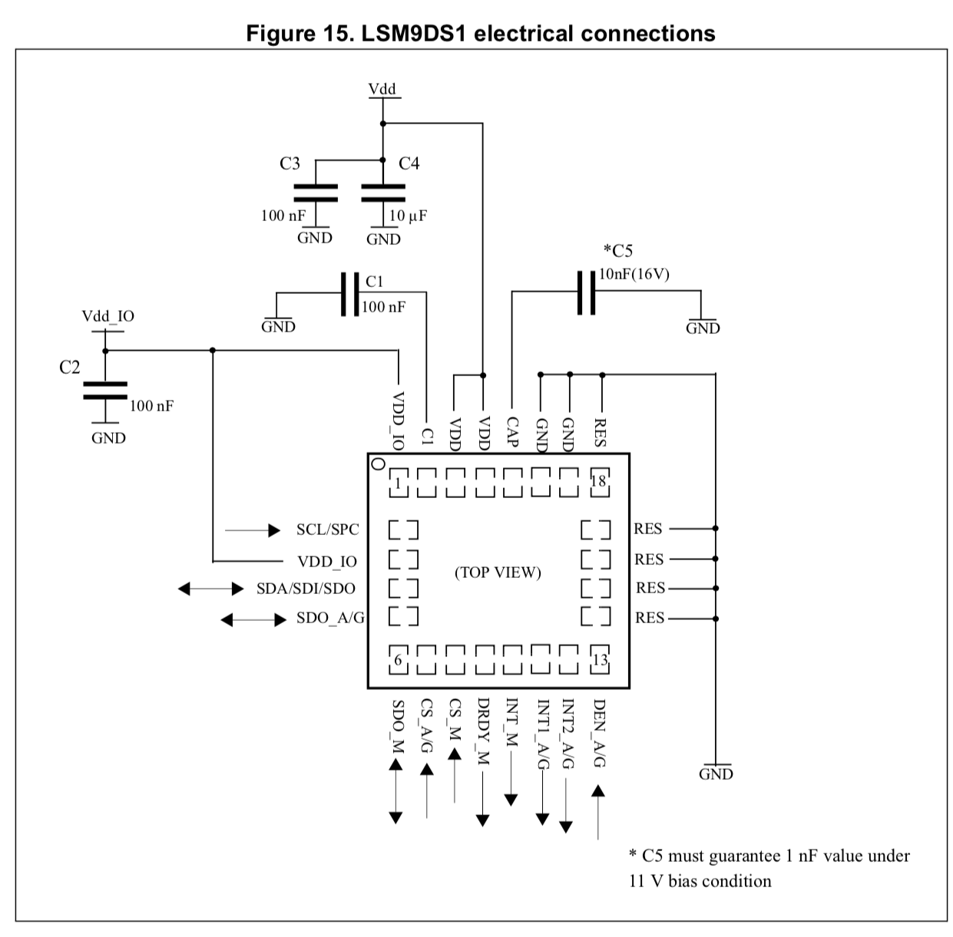
IMU Datasheet
Sections 4 and 5-5.1

Slide 22
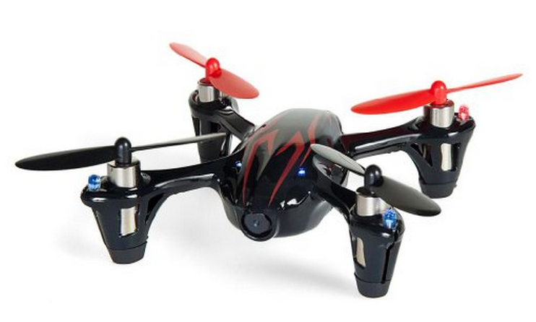
Motors and Props
Plenty of power
DC brushed motors
They draw ~2A each.

Slide 23
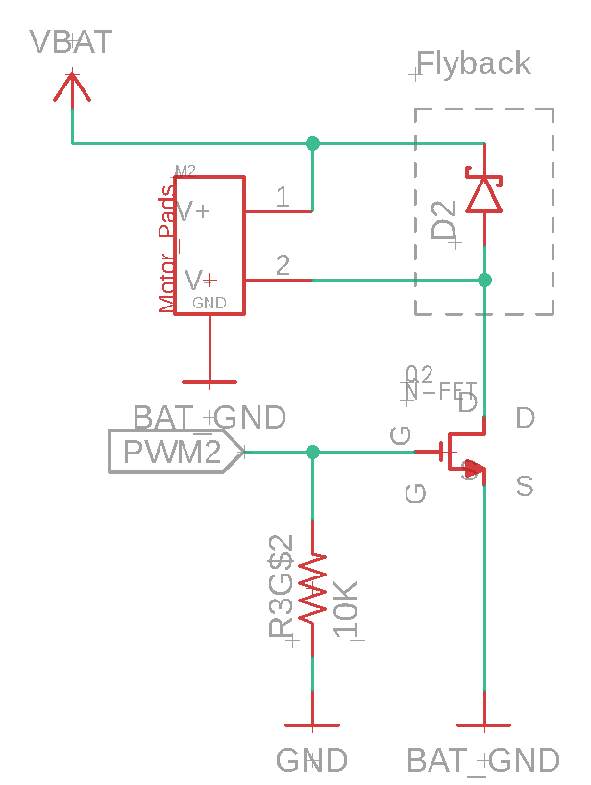
Motor Driver
Pulse-width modulation (PWM)-controlled MOSFET
The microcontroller will drive the MOSFET
The MOSFET will drive current to the motor.
A diode handles the inductive load from motor when it turns off (“flyback”)
Pull down resistor so it defaults to ‘off’.

Slide 24
Pulse Width Modulation
Motor speed varies with voltage
Varying the voltage directly is hard
PWM varies the average voltage using a digital signals
Duty cycle: % of time signal is high
Cycle time: delay between rising edges (2ms on our MCU)
Frequency: 1/Cycle time (490Hz)
Our MCU has hardware for this
Accessed via analogWrite()
Cycle time = 2ms
Frequency = 490Hz

Slide 25
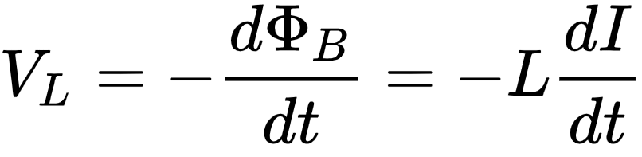
Motor Switching: Inductance and Flyback
Inductance -- Resistance to a change in current
Current takes time to start and stop flowing.
Imagine water flowing in a pipe when you turn off the faucet.
Formally, changing current (I) creates a voltage (V_{L}) proportional to the rate of change and the inductance (L)

Slide 26
Motor Switching: Inductance and Flyback
Motors are inductors (and resistors)
Motor voltage equation
Vm = voltage across the motor
I = Motor current
R = Motor resistance
L = Motor Inductance
dI/dt = rate of change of motor current

Slide 27
Motor Switching: Inductance and Flyback
Add a ‘fly back diode’
When the switch is closed
No effect (reverse-biased)
When the switch is closed
Forward-biased
Routes current back into the motor
Good videos
https://www.youtube.com/watch?v=6R_3jHeimiE
https://www.youtube.com/watch?v=m5JYkgCRbBI&t=1s

Slide 28
LEDs
You will add some LEDs to you quadcopter.
Three steps
Design your lighting scheme
Pick them on Digikey.com
Design the circuit to control them

Slide 29
LED Design
Functional
Which way is forward?
Status information
Pretty
Ground effects
Display your quad’s mood
Options
“indicator” LEDs draw a few mA
“lighting” LEDs can draw up to several amps.
Constraints
0.5 A maximum across all your LEDs

Slide 30
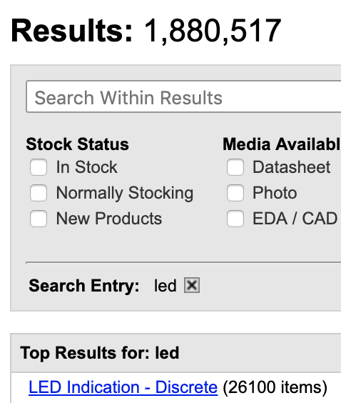
LED Selection
There are lots of LED
You will pick them on digikey
Must be at least 0805 (2mm x 1.25mm)
Available in quantities of 1
Cost < $1 per LED

Slide 31
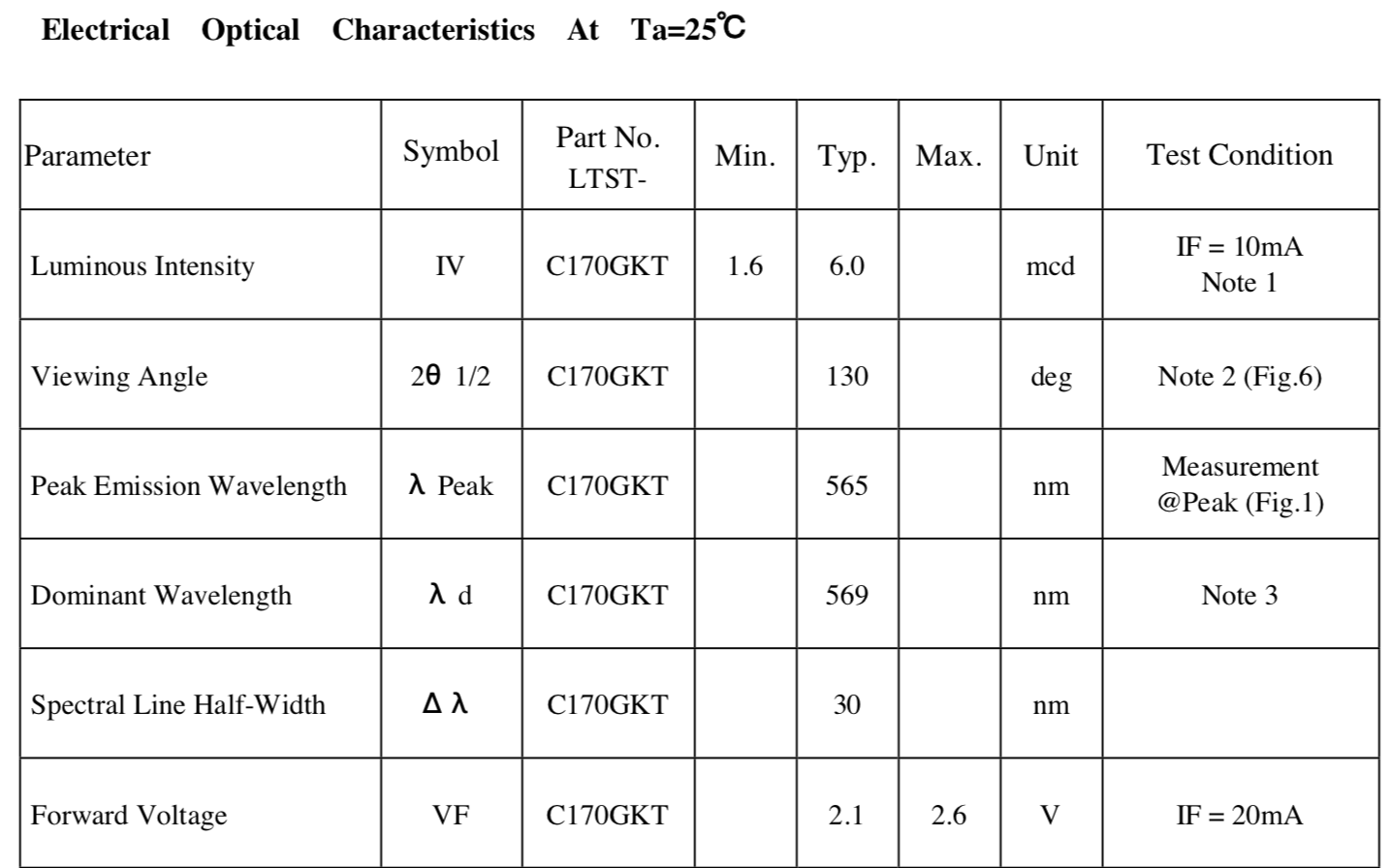
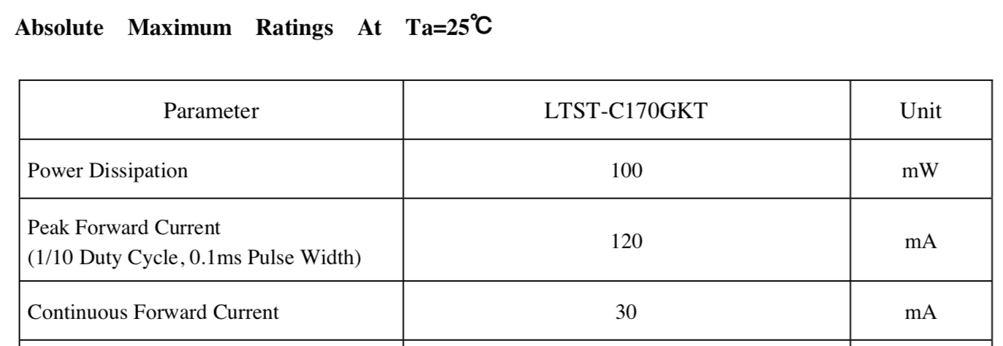
LED Datasheets
Key device parameters
Forward voltage: V_{f}
Color
Luminous intensity
Key absolute limits
Forward current

Slide 32
LED Circuit design
Ohm’s Law : V = IR
The forward voltage (V_{f}) across an LED is (roughly) fixed
Driving the LED at > V_{f} will burn it out.

Slide 33
Limiting Current
Ohm’s Law : V = IR
The forward voltage (V_{f}) across an LED is (roughly) fixed
Add a resistor to limit current.

Slide 34
Set Your Brightness Carefully
Indicator LEDs do not need to be driven hard
The red LED on the FCB uses a 510Ω resistor
Vf = 2V; Vcc = 3.3
I = V/R => I = (3.3-2.0)/510 = 2.5mA
The maximum brightness (@30mA) is 12x higher
They can easily become blindingly bright.

Slide 35
Controlling your LEDs
Drive directly with MCU pin
Good for indicators
< 10mA/LED
Use a PWM pin to make them dimmable
Drive via MOSFET (digital or PWM)
Good for bright LEDs
<500mA total.
You can run several LEDs in series if V_{f} is low enough.
You can run them in parallel too, but brightness will vary.
You can also just wire them to power.

Slide 36
Turning in your LED design
Pick your LEDs
Commit your datasheets
Create the Eagle library (including any resistors your need)
Add led_notes.txt, explaining your design.

Slide 37
Demo
Schematic organization
Connection via named nets
Using ‘show @’ to check connectivity
Explain how Eaglint checks things (path based patterns).

Slide 38
Building a Schematic Demo
Dr. Steven Swanson
CSE176e/276e
swanson@cs.ucsd.edu

